Slide 1
ProQuest ETD Administrator
Usability Evaluation and Needs Assessment
Team Visionaries
Zi Wang, Catherine Zhou, Kay Malan, Henry Jackson, Sufyan Hammoudeh

Slide 2
Overview
ProQuest ETD Administrator is an online submission tool for theses and dissertations. Used by a multitude of different institutions, the platform aims to simplify and expedite the ETD submission process.
ProQuest’s user base includes graduate students such as master’s and PhD students working on a thesis or dissertation. University administrators tasked with communicating revision requirements and approval are also users of the platform.

Slide 3
Research Goals & Objectives
The research goals we established across our multitude of investigations can be separated into four main categories. These categories center around specific features, specific processes, site clarity, and user satisfaction. We’ve distilled down our research questions as follows.
To what extent do specific features (i.e. help function, special offer pop-up) support/improve the user experience on ProQuest ETD Administrator?
When it comes to instructional content, what specific issues hinder user understanding? How can clarity be improved?
Are users experiencing a smooth, easy process throughout all steps of the submission process? What are the areas that could benefit from the most improvement?
How satisfied are ProQuest’s users? What are some factors that play a role in user satisfaction/dissatisfaction?

Slide 4
Methods
01
02
03
Interaction Map
Understand the
user flow of interaction
User Interview
Gather insights of
user needs and preferences
Surveys
Validate the findings from a larger sample of users
04
05
06
Comparative Evaluation
Identify strengths and weaknesses relative to competitors
Heuristic
Evaluation
Assess the product based on Nielsen's 10 usability heuristics to recognize specific usability issues
Usability Test Analysis
Observe user behaviors, record the data, and analyze it based on established metrics

Slide 5
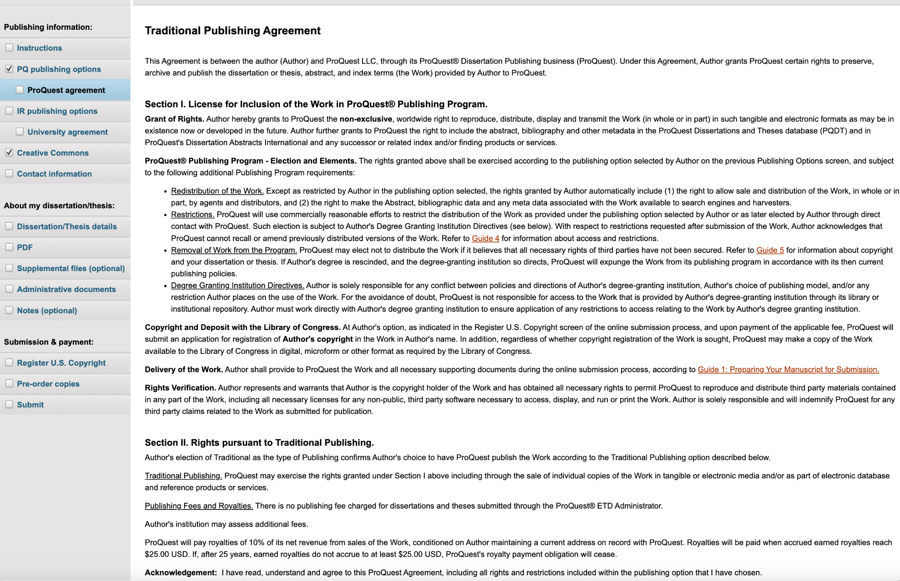
Findings
Issues Concerning Instructional Clarity
Instructional clarity concerns, suggested supplemental video (interviews)
ProQuest has a straightforward process of publishing, but falls short in providing a transparent track of the reviewing process. (Comparative Eval)

Slide 6
Findings
Issues Concerning Layout and Site Design
Challenges with Page Layout: Clarity and Easy Access (Heuristic Eval)
Visibility of System Status
Issues involving formatting and indicators were identified on the “Pre-order copies” page
Error Prevention
The lack of borders around the text on the “Submit” page makes the submission summary visually overwhelming
Flexibility and Efficiency of Use
When uploading a copy of their thesis/dissertation, there is no option for the user to drag and drop their file
Preference for Traditional over Open Access due to cost concerns and lack of benefit clarity (Usability Test)
4 out of 5 users chose traditional access almost immediately, despite instructions to select an option that allows full-text access for everyone.

Slide 7
Recommendations (Layout and Design)
Redesign input box and sizing graphic
Add additional graphics/visuals
Convert input box into a stepper to clarify its function.
Redesign the book size diagram to prevent users from mistakenly clicking on the image to select the size.
Alternatively, convert the size diagram to a clickable format and adjust input fields accordingly.
This will help users have a easier experience navigating throughout the submission process.
Increase font size and weight (certain pages)
Add borders/text boxes to improve readability
The lack of borders around the text on the “Submit” page makes the submission summary visually overwhelming.
Increase font size to make tooltips more legible.
Reformat font size and weight on the “PDF” page to ensure users are able to quickly and easily understand status indicators.

Slide 8
Recommendations (Instructional Clarity)
Add a FAQ section to the help page
Enhance visibility of Open Access benefits
Add a FAQ section to the top of the help landing page.
Both P1 and P3 indicated that a browsable FAQ section would be helpful there.
Clearly highlight the advantages of choosing Open Access over Traditional Access.
Use concise language and engaging visuals to illustrate its broader dissemination benefits.
Clarify the offer details and emphasize its exclusivity
Highlight differences and suggest typical use cases for licensing options
Add additional videos, student perspectives, or a chart/table to show differences in access to the Creative Commons page.
Highlight most commonly chosen options.
Improve clarity on the pricing and benefits of the special offer
Emphasize this is a one-time offer through visual cues and comparison charts to highlight the exclusivity and urgency of the deal.

Slide 9
Recommendations (Instructional Clarity) Contd.
Fragment the Text
Expand supplemental content and add video instructions
Feedback includes suggestions such as “less text.”
“Add some interactive content to describe features” (P4) to improve engagement.
“Fragment the text and screens” (P5) to enhance readability.
This will help users better understand how to use the platform.

Slide 10
Discussion
Shortcomings:
1. Inadequate Sample Diversity and Size
The data collection has involved limited numbers of samples, which may not fully represent the diversity of user experiences across different disciplines.
2.Outdated System Versions and Recency of User Interactions
Given that the demo site we tested may not accurately represent all updates and features present on the live site, the accuracy of user feedback was affected. This could lead our findings to potentially overlook some issues. Additionally, user interviews typically referenced past interactions, leading to less precise responses due to faded memories. These issues combine to limit the reliability of data on current user experiences and system performance.
Next research steps:
Implement Continuous Feedback Loops to gather ongoing, real-time feedback from users.
Increase the scale of user research efforts to include larger sample sizes and diverse groups, validating current findings and establishing a more comprehensive understanding of user needs.
User Interviews Conducted: #5
Usability Tests Conducted: #5

Slide 11
Shortcomings
User Interviews Conducted: | #5
Usability Tests Conducted: | #5
Inadequate Sample Diversity and Size
Outdated System Versions and Recency of User Interactions
The data collection has involved limited numbers of samples, which may not fully represent the diversity of user experiences across different disciplines.
Given that the demo site we tested may not accurately represent all updates and features present on the live site, the accuracy of user feedback was affected. Additionally, user interviews typically referenced past interactions, leading to less precise responses due to faded memories.

Slide 12
Next research steps
Implement Continuous Feedback Loops to gather ongoing, real-time feedback from users.
Increase the scale of user research efforts to include larger sample sizes and diverse groups, validating current findings and establishing a more comprehensive understanding of user needs.
…

Slide 13
Thanks!
SI 622
Team Visionaries
Client:
ProQuest ETD Administrator
Please keep this slide for attribution

